Slide 1
Final Project: Flask Healthcare Application
Submitted by Hassan Abbas
Learner ID: 137499

Slide 2
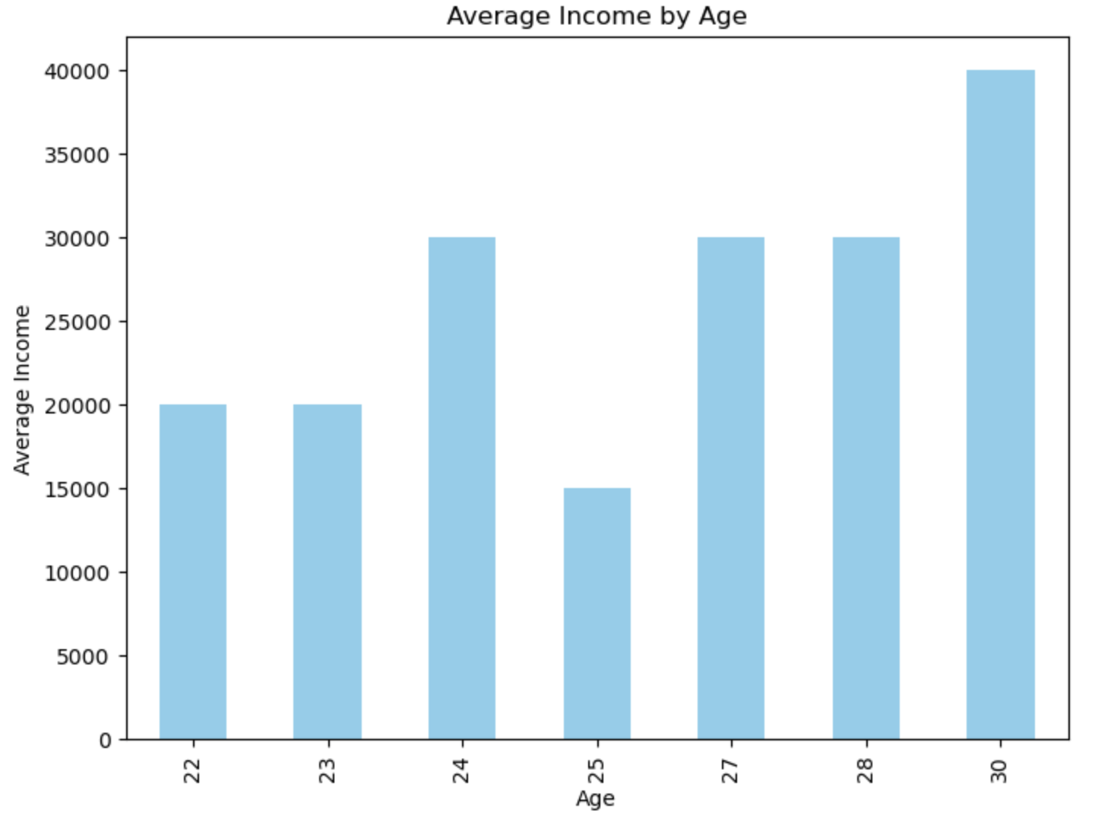
Average Income by Age

Slide 3
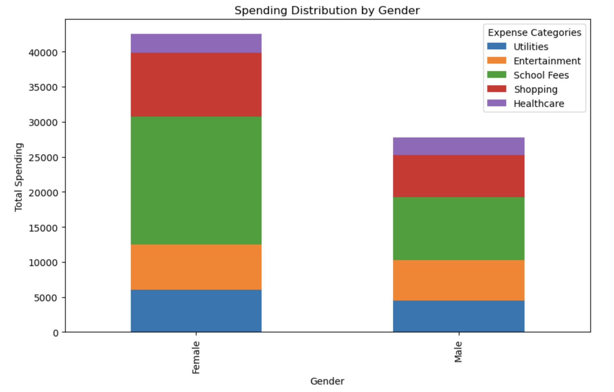
Spending Distribution by Gender

